Slide 1
AI CHATBOT
WITH PROGRAMMABLE IDENTITY

Slide 2
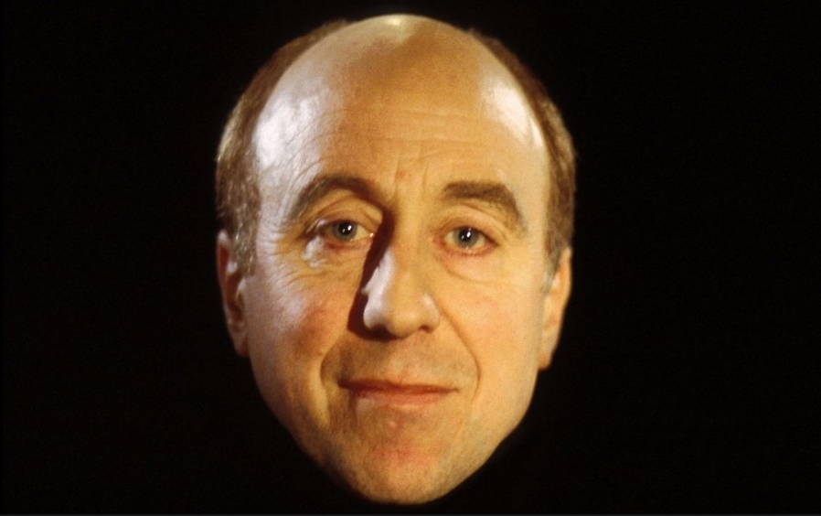
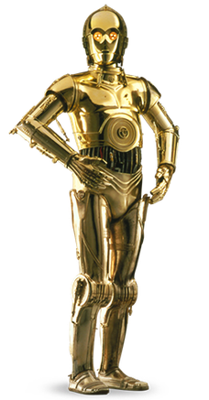
Motivations
C3PO
Holly

Slide 3
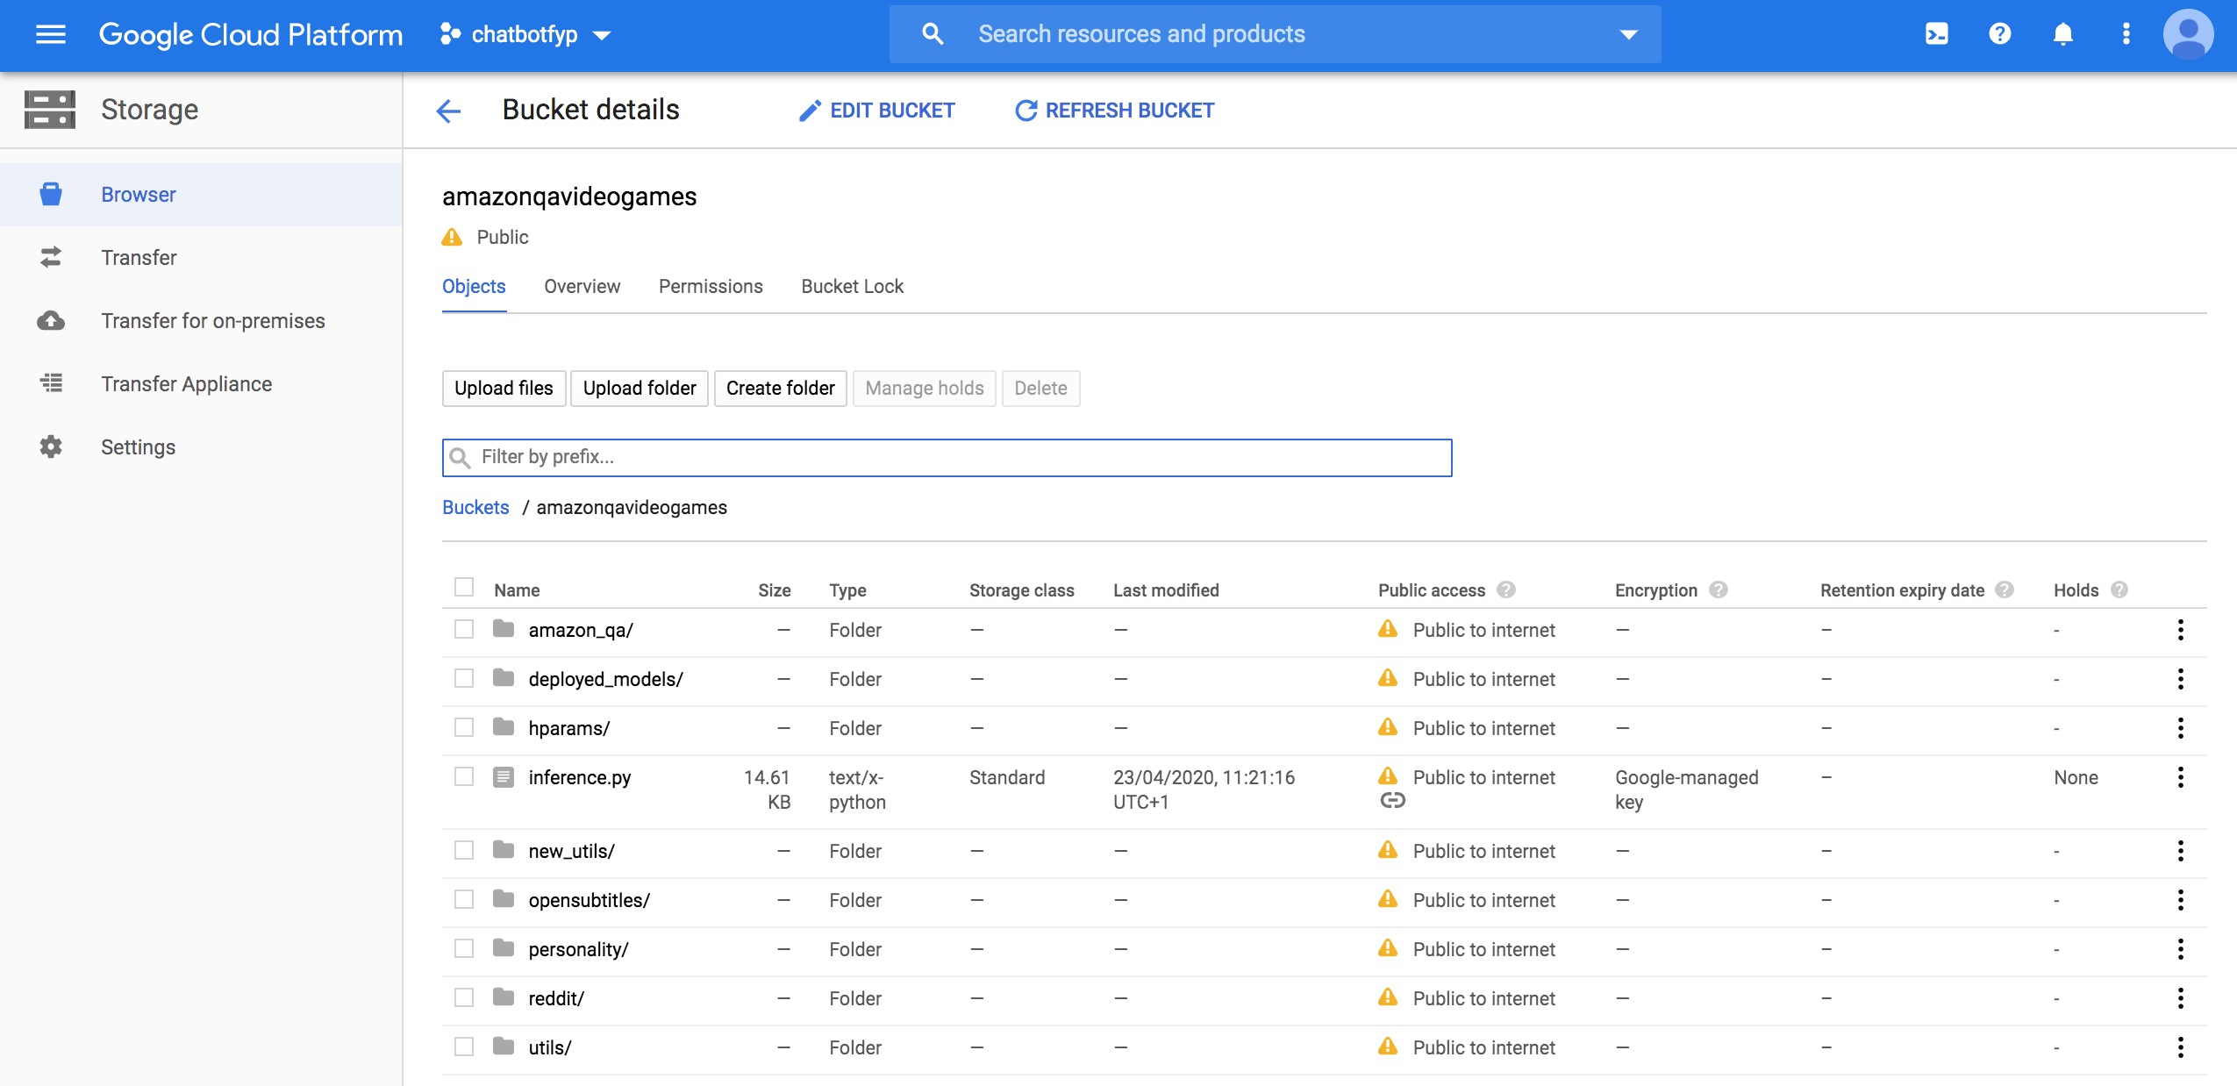
Google cloud

